Slide 1
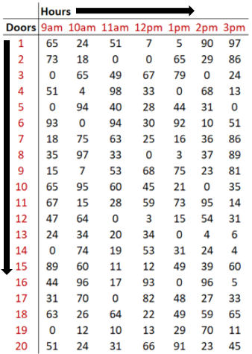
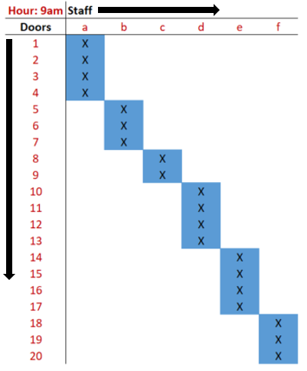



Staff-to-Door Allocation (SDA) Overview
Staff-to-Door Allocation (SDA) is a tool that enables outbound floor managers to make optimal decisions when assigning staff to doors.
SDA is designed to make the job of a floor manager easier, while simultaneously enabling the productivity of staff to be maximized throughout the day.
Data Input
Model Output
Allocation
Execution
Results
SDA receives data from facility’s automated sorting system, showing where cartons will be routed over course of the next hour*.
SDA creates a report for the management team that contains optimal assignments of staff to sets of doors.
Managers inform staff of their door assignments for the next hour.
Staff members work their assigned sets of doors until the next assignment.
Productivity increases, improving facility performance and minimizing labor cost.
*SDA can also be run once per day, or at any time interval that makes sense for the facility

Slide 2
Other Applications of Optimization
While SDA is designed to optimize decisions in outbound operations, there are several other applications related to elements occurring earlier in the distribution process
Process | Application | Key Question
Inbound | Truck-to-Door Sequencing | How should I sequence the assignment of delivery trucks to inbound doors to avoid causing congestion as soon as new cartons are inducted into the system?
 | Staff-to-Door Allocation | What is the best assignment of staff to doors that enables my staff to be as productive as possible?
Warehousing | Staff-to-Aisle Allocation | What is the best assignment of staff to warehouse aisles that enables my staff to be as productive as possible?
 | Throughput Benchmarking | What is the most volume I can reasonably process through the facility in a day?
Outbound | Door-to-Store Re-Mapping | What is the best “map” or door-to-store configuration of outbound that minimizes congestion/need to re-allocate staff?
 | Staff-to-Door Allocation | What is the best assignment of staff to doors that enables my staff to be as productive as possible?

